Slide 1
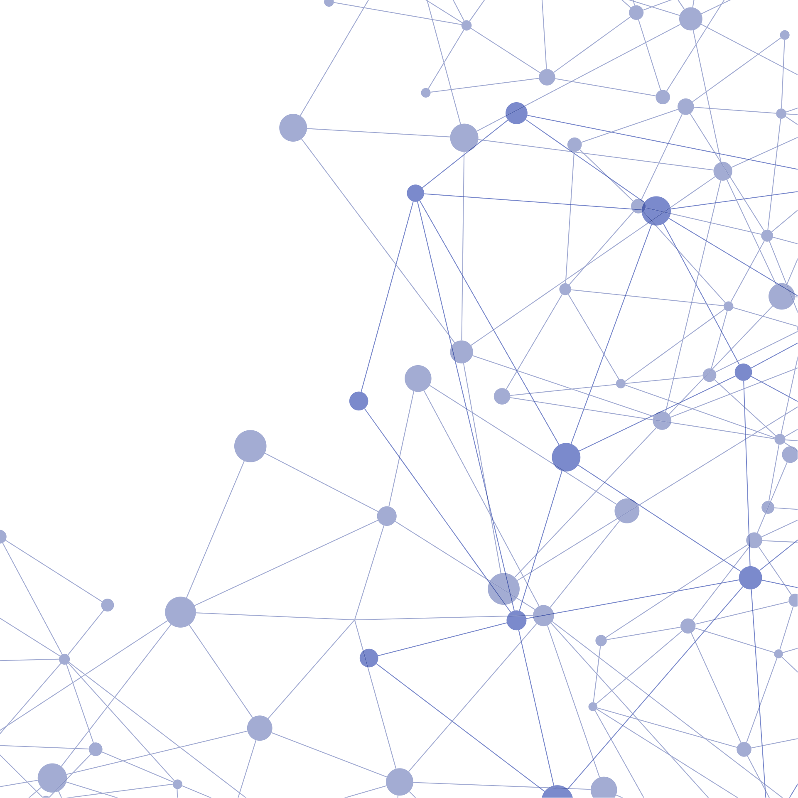


DIGITAL FAIR SKILL 35.0
SIMPLE CLASSIFCATION OF
IRIS DATASET
USING MACHINE LEARNING
BY
NI PUTU ESSA KIRANA PRAYASCITA

Slide 2





DIGITAL FAIR SKILL 35.0
The Iris dataset is a widely used dataset from the Scikit-learn library, consisting of 150 samples representing three species of Iris flowers: Iris setosa, Iris versicolor, and Iris virginica. Each sample includes four numerical measurement features:
Sepal length (in centimeters)
Sepal width (in centimeters)
Petal length (in centimeters)
Petal width (in centimeters)
These features capture the physical dimensions of the Iris flowers, aiming to highlight the morphological differences between the species for exploring patterns and predict the relationships in data.
ABOUT
IRIS DATASET

Slide 3



DIGITAL FAIR SKILL 35.0
INFORMATIONS
ATTRIBUTES
Number of attributes:
4 numerical attributes used as features to predict the target variable
Attributes Characteristic:
Sepal Length (cm), Sepal Width (cm), Petal Length (cm), Petal Width (cm), and the target variable, which is the species of the flower (Iris setosa, Iris versicolor, and Iris virginica). Each species consist of 50 samples.

Slide 4


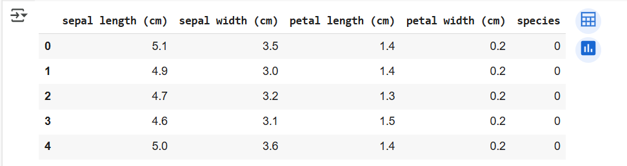

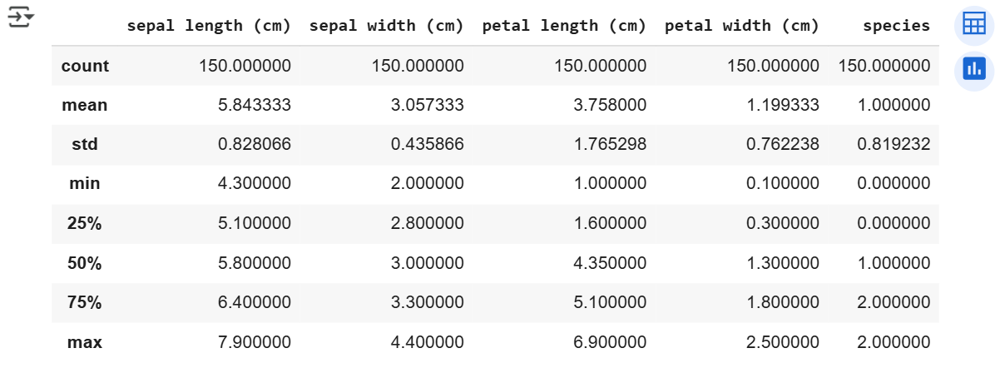
DIGITAL FAIR SKILL 35.0
(EDA)
EXPLORATORY DATA ANALYSIS
IRIS DATAFRAME

Slide 5


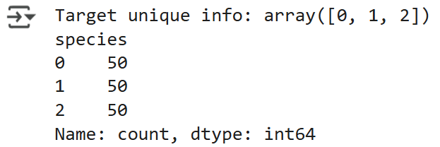
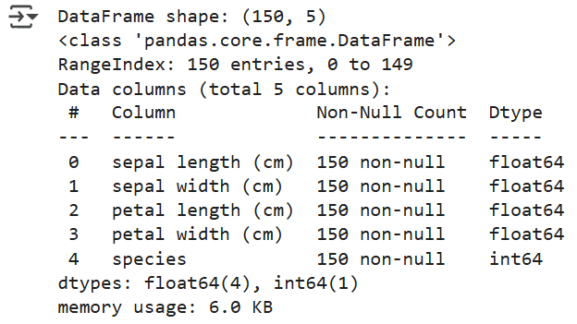


DIGITAL FAIR SKILL 35.0
(EDA)
EXPLORATORY DATA ANALYSIS
DATAFRAME INFORMATIONS

Slide 6


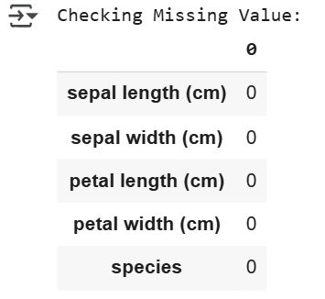
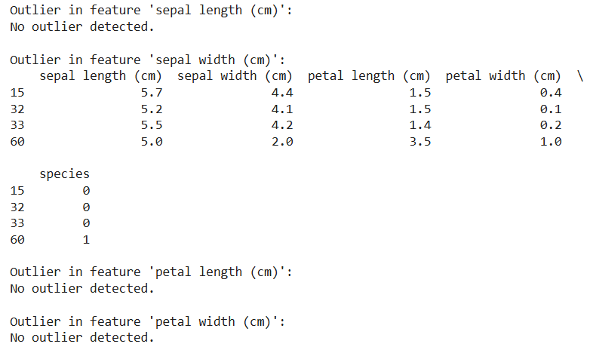


DIGITAL FAIR SKILL 35.0
PRE-PROCESSING
DATA

Slide 7
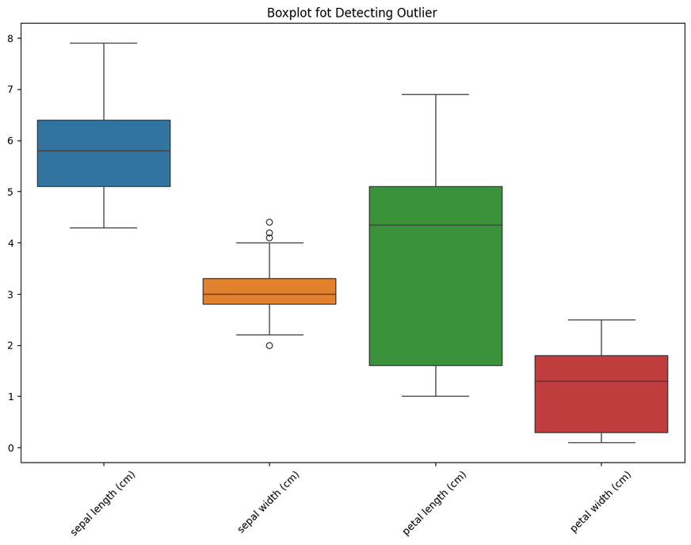

DIGITAL FAIR SKILL 35.0
OUTLIER VISUALIZATION
DATA
PRE-PROCESSING

Slide 8

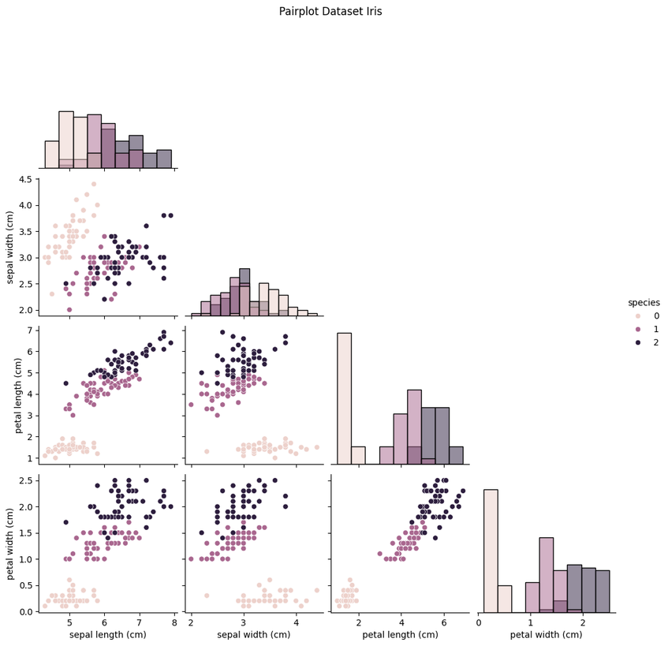
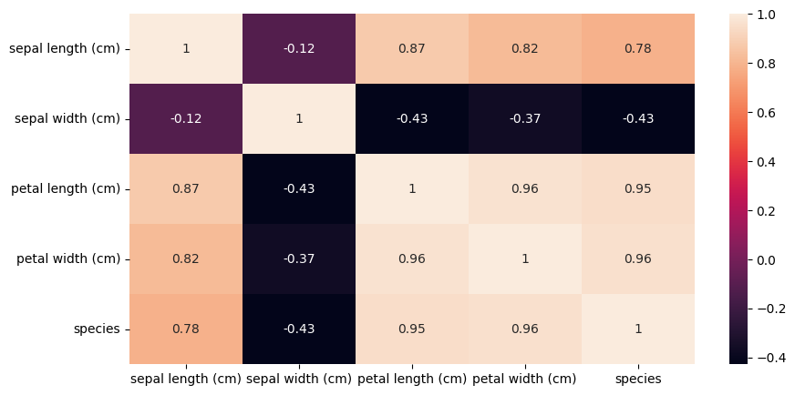
DIGITAL FAIR SKILL 35.0
VISUALIZATION
DATA

Slide 9
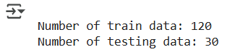

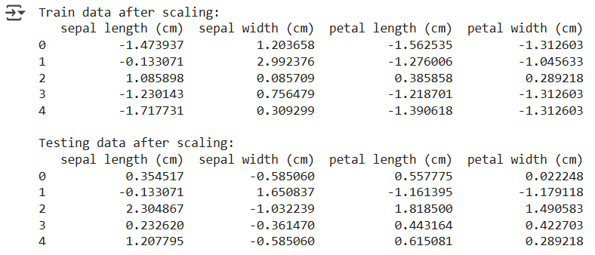
DIGITAL FAIR SKILL 35.0
SPLITING
AND SCALING

Slide 10
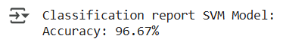
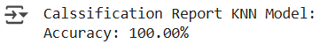

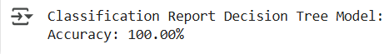
DIGITAL FAIR SKILL 35.0
ACCURACY
MODEL

Slide 11
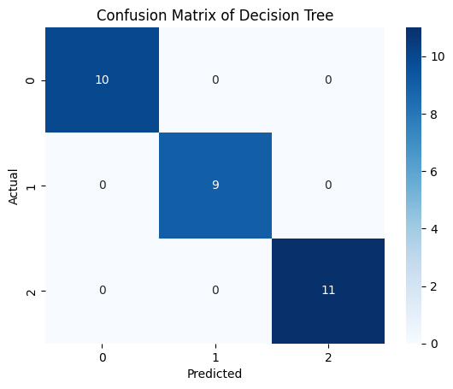
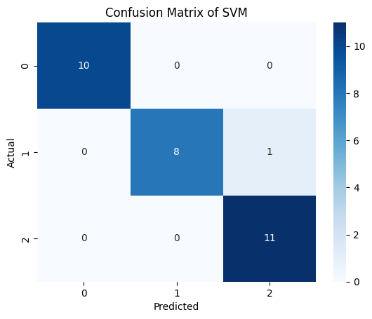


DIGITAL FAIR SKILL 35.0
VISUALIZATION COMPARISON
MODEL

Slide 12


DIGITAL FAIR SKILL 35.0
CONCLUSION
Although KNN and Decision Tree achieved perfect accuracy (100%), the SVM model (96.67%) is chosen as the best model. SVM model has better generalization ability and resistance to overfitting, making it more stable and reliable for new data.

Slide 13


EMAIL
essakiranaprayascita@gmail.com
GET IN
http://linkedin.com/in/ni-putu-essa-kirana-prayascita-3930a2287
TOUCH
LINKEDIN
GITHUB
https://github.com/essakirana
YOU
THANK

